Slide 1
Application-Driven Research in the
ASPIRE Lab
Michael Anderson, Khalid Ashraf, Gerald Friedland, Forrest Iandola, Peter Jin, Matt Moskewicz, Zach Rowisnki, Kurt Keutzer,
and former members of the PALLAS team
forresti@eecs.berkeley.edu

Slide 2
The Applications Layer
this talk:
Emerging Applications
Interactive Cloud
Cancer Genomics
Machine Learning
Graph Processing
Multimedia Analysis
Computer Vision
Software Radio
Applications
Computational and Structural Patterns
Algorithms
Communication-Avoiding Algorithms
Productivity Languages (Python, Scala) with Pattern Frameworks
Productivity Layer
Pattern Specializers
(ASP, TFJ, Spade)
Efficiency Languages
(C++, CUDA/OpenCL, JVM)
Pattern-Specific VMs
ESP LLVM Compiler
Chisel Patternflow
Performance/Energy/Error
Simulation and Modeling
Efficiency Layer
Vendor Compilers
Hardware Patterns
Chisel HDL
OS
Runtimes, OS, Hypervisor, Cluster Manager
COTS
CPU/GPU
ESP: Ensembles of Specialized Processors
Hurricane Spatial Computing Fabric
COTS Tools
Architecture
FPGA
ASIC
Memories, Interconnects, I/O
Circuits
Energy-Efficient Resilient Circuit Design
Systems
Racks (10s kW)
Embedded (10 kW-1W)
Mobiles (1W)

Slide 3
Our Formula
Identify key growth areas for industry at large and especially our sponsors
Identify key applications in these growth areas
Apply a patterns-oriented approach with SEJITS to create a supportive software environment to map these applications onto commercial and our own hardware
That worked really well in Par Lab for mobile and laptop apps, let’s try that again
This time, let’s focus on low-latency applications in clusters (1-20 servers) / clouds (~200) / datacenters (~2000)
We’d like sponsor feedback on these applications …
Forrest Iandola forresti@eecs.berkeley.edu
Notes:
Identify recurring patterns across the apps, and enable better energy efficiency and speed for these patterns.

Slide 4
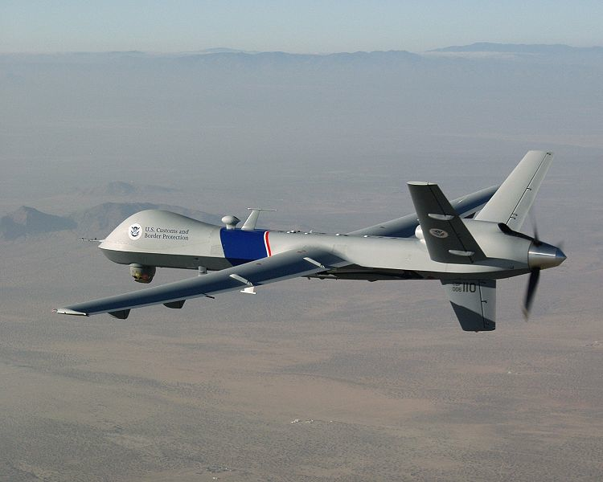
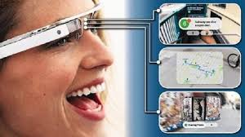

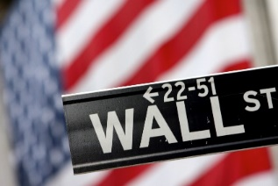
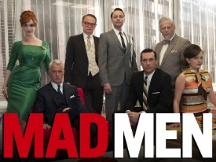
What’s Trending …
UAVs with onboard cameras & data analysis
Mobile/wearable computing with client/cloud interaction
Big Data Analytics: Making sense out of a tsunami of consumer generated video media
Increasing automation of financial industry
Increasing automation of internet advertising
Forrest Iandola forresti@eecs.berkeley.edu

Slide 5
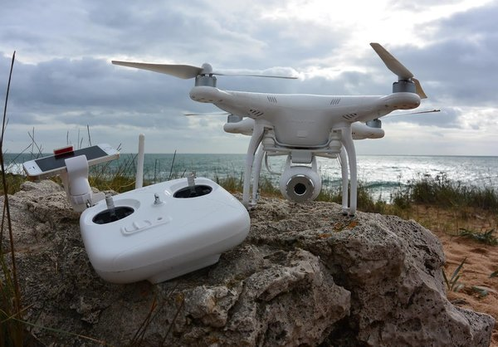
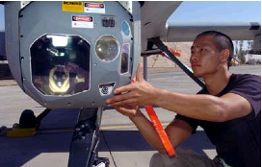
Trend #1: UAVs with onboard analysis
  $100 Billion will be spent on UAVs / drones over next 10 years [1]
    90% military, 10% commercial/civilian
  UAVs with high-end onboard cameras
Phantom 2 Vision Photo Drone From DJI
Source: New York Times
Predator MQ-9 UAV
Raytheon Multi-Spectral Targeting System
[1] http://www.businessinsider.com/the-market-for-commercial-drones-2014-2

Slide 6
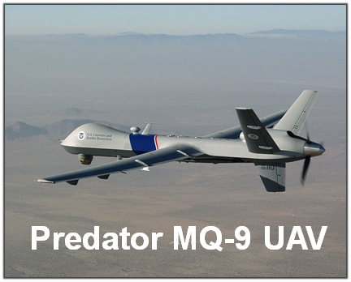
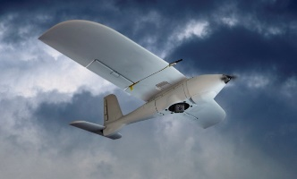
UAV Computer Vision Application
  Key Application: Target tracking aimed to use the video capabilities in the Predator MQ-9
    Automated detection
    Target tracking
    Surveillance
Performance Goal: 140 Frames/kJoule for 2048x2048 frames
  2000× improvement over state of the art
Civilian Market 2016: E $1B
Military Market 2016: E $6B
Predator MQ-9 UAV
http://www.businessinsider.com/drones-navigating-toward-commercial-applications-2-2014-1

Slide 7
Patterns in Emerging Markets
 | Web Search | Social Networks | Database | Big Data Analytics | HPC | Genomics
Graph Algorithms
Graphical Models
Backtrack / B&B
Finite State Machines
Circuits
Dynamic Programming
N-Body
Unstructured Grid
Structured Grid
Dense Matrix
Sparse Matrix
Spectral (FFT)
Monte Carlo
Apps
Krste showed a version of the Application/Pattern mapping in his talk
Now, let's update this for emerging applications…
Patterns
Forrest Iandola forresti@eecs.berkeley.edu

Slide 8
Patterns in UAV Computer Vision
 | Web Search | Social Networks | Database | Big Data Analytics | HPC | Genomics | UAV Vision
Graph Algorithms
Graphical Models
Backtrack / B&B
Finite State Machines
Circuits
Dynamic Programming
N-Body
Unstructured Grid
Structured Grid
Dense Matrix
Sparse Matrix
Spectral (FFT)
Monte Carlo
Apps
Patterns
Forrest Iandola forresti@eecs.berkeley.edu

Slide 9
Trend #2: Wearable
Mobile/wearable computing with client/cloud interaction
Wearable computing will be a $30-50 billion market by 2017 [1]
In 2017, smartglasses may begin to save the field service industry $1 billion per year through improved efficiency. [2]
Can our UAV vision algorithms (e.g. optical flow) support wearable computing?
[1] www.businessinsider.com/wearable-technology-market-2013-5
[2] Smartglasses Bring Innovation to Workplace Efficiency, Gartner, 10/2013

Slide 10
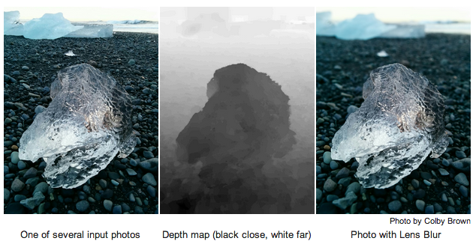
Wearable/Mobile Application:
Depth of Field
  Use our Optical Flow application capability for high-quality depth maps on mobile/wearable devices
  A depth map improves object recognition [1] and has other uses [2]
  Achieving 0.2 GFLOPS/W on mobile GPU (see Michael Anderson's poster)
[1] Bo, L., Ren, X., & Fox, D. (2013, January). Unsupervised feature learning for RGB-D based object recognition. In Experimental Robotics (pp. 387-402). Springer International Publishing.
[2] Lens Blur in the new Google Camera app. Google Research Blog
http://googleresearch.blogspot.com/2014/04/lens-blur-in-new-google-camera-app.html
Forrest Iandola forresti@eecs.berkeley.edu
Notes:
So we'd like to get some dual use out of our optical flow expertise.
1. improve obj rec using depth map
2. compute depth map on the phone with optical flow
The image on the right is from [2]

Slide 11
Patterns in Wearable Computer Vision
 | Web Search | Social Networks | Database | Big Data Analytics | HPC | Genomics | UAV & Wearable Vision
Graph Algorithms
Graphical Models
Backtrack / B&B
Finite State Machines
Circuits
Dynamic Programming
N-Body
Unstructured Grid
Structured Grid
Dense Matrix
Sparse Matrix
Spectral (FFT)
Monte Carlo
Apps
Patterns
Forrest Iandola forresti@eecs.berkeley.edu

Slide 12
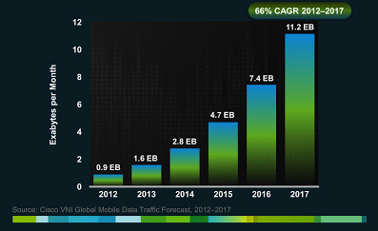
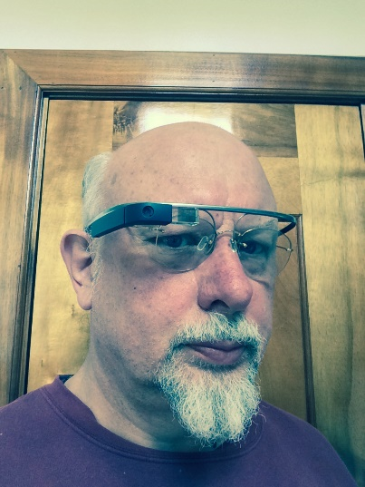
Trend #3: Big Data Analytics
Big Data Analytics: Making sense out of a tsunami of consumer generated video media
Mobile data traffic projection
2/3 of this is video
Source: Cisco Visual Networking Index: Global Mobile Data Traffic Forecast Update, 2013–2018
Notes:
FIXME: "internet video to TV"
get a better chart
so much more video with google glass than when people had sony camcorders

Slide 13
PyCASP SEJITS Framework for Big Data Multimedia Analysis
Library Components
Customizable Components
FFT
SVM
SVM
Wiener Filter
+
HMM
GMM training
;
GMM Eval
Structural Patterns
GMM
GMM
GMM
GMM
GMM
SVM
Forrest Iandola forresti@eecs.berkeley.edu
Notes:
To do that analytics, we want…
Ability to do both
Write arbitrary Python code and use library and/or customizable components as library calls
Write a more structured code with clear abstractions – more restrictive, but allows for faster/more efficient implementations
? How to guide the programmer which to use ?

Slide 14
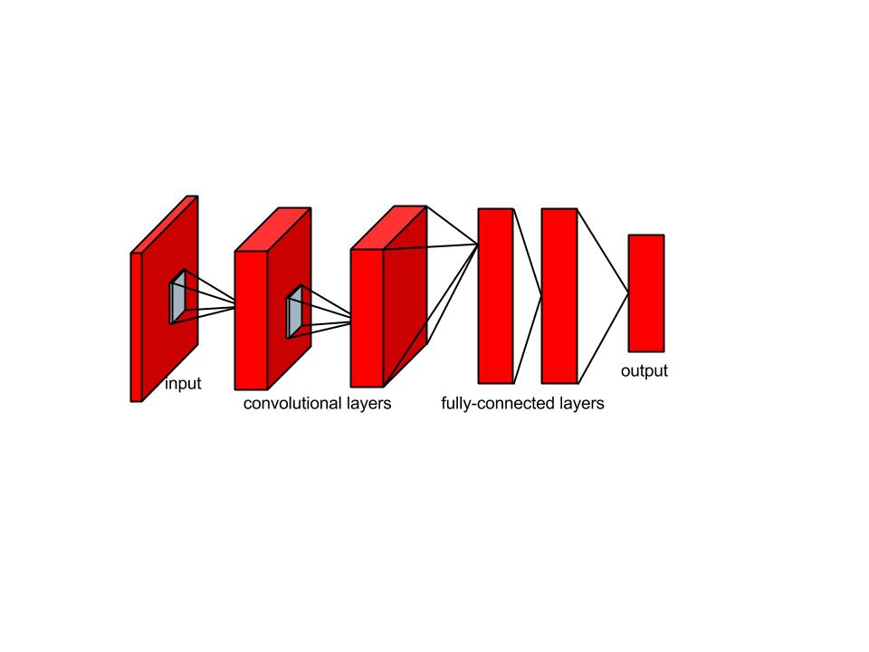
Adding Deep Learning to our PyCASP SEJITS Framework for Media Analysis
Long-time collaboration with Gerald Friedland of ICSI on taming the multimedia tsunami
Friedland identified Deep Learning as a key building block for high-quality multimedia analysis; incorporating it into PyCASP
Visual recognition: 10x speedup by rethinking deep neural net computation (see Forrest Iandola's poster)
Audio recognition: equivalent result with 15x reduction in dimensionality of input features (see Khalid Ashraf's poster)
deep neural network
Notes:
Some folks were here for ParLab. You heard about PyCASP, we're extending that…

Slide 15
Patterns in Big Data Multimedia Analysis
 | Web Search | Social Networks | Database | Big Data Analytics | HPC | Genomics | UAV & Wearable Vision | Big Data Multimedia
Graph Algorithms
Graphical Models
Backtrack / B&B
Finite State Machines
Circuits
Dynamic Programming
N-Body
Unstructured Grid
Structured Grid
Dense Matrix
Sparse Matrix
Spectral (FFT)
Monte Carlo
Apps
Patterns
Forrest Iandola forresti@eecs.berkeley.edu
Notes:
TODO: make this for the ASPIRE
COLORS:
Blue -> white
Heatmap colors instead of random colors
Along the top (areas)…
Broad App Areas
Search
Databases
Unbucketed Hadoop based apps?
Machine Learning
Graphs and social network analysis
Specific Apps
Finance – Sparse Matrix
Advertising
Wearable/Mobile: Optical Flow (could be "Image")
Multimedia (formerly Speech)
Genomics
Visualization: bottlenose, Leo/Graphistry
(parlab experts)
Database – joe hellerstein
ML – Mike Jordan
HPC – Demmel
CAD -- Kurt

Slide 16
We’re Not Alone in Our Enthusiasm for Patterns in Big Massive Data
National Research Council of the National Academies examines the Future of Big Data
Chapter 10:
The Seven Computational Giants of Massive Data Analysis
1. Basic statistics,
2. Generalized N-body problem,
3. Graph-theoretic computations,
4. Linear algebraic computations,
5. Optimization,
6. Integration, and
7. Alignment problems.
Notes:
Patterns really took off with the Par Lab and the Berkeley View paper but the enthusiasm spread to the National Research Council. In their Book “Frontiers in Massive Data Analysis” they devoted a chapter to patterns. We have integrated their findings.

Slide 17
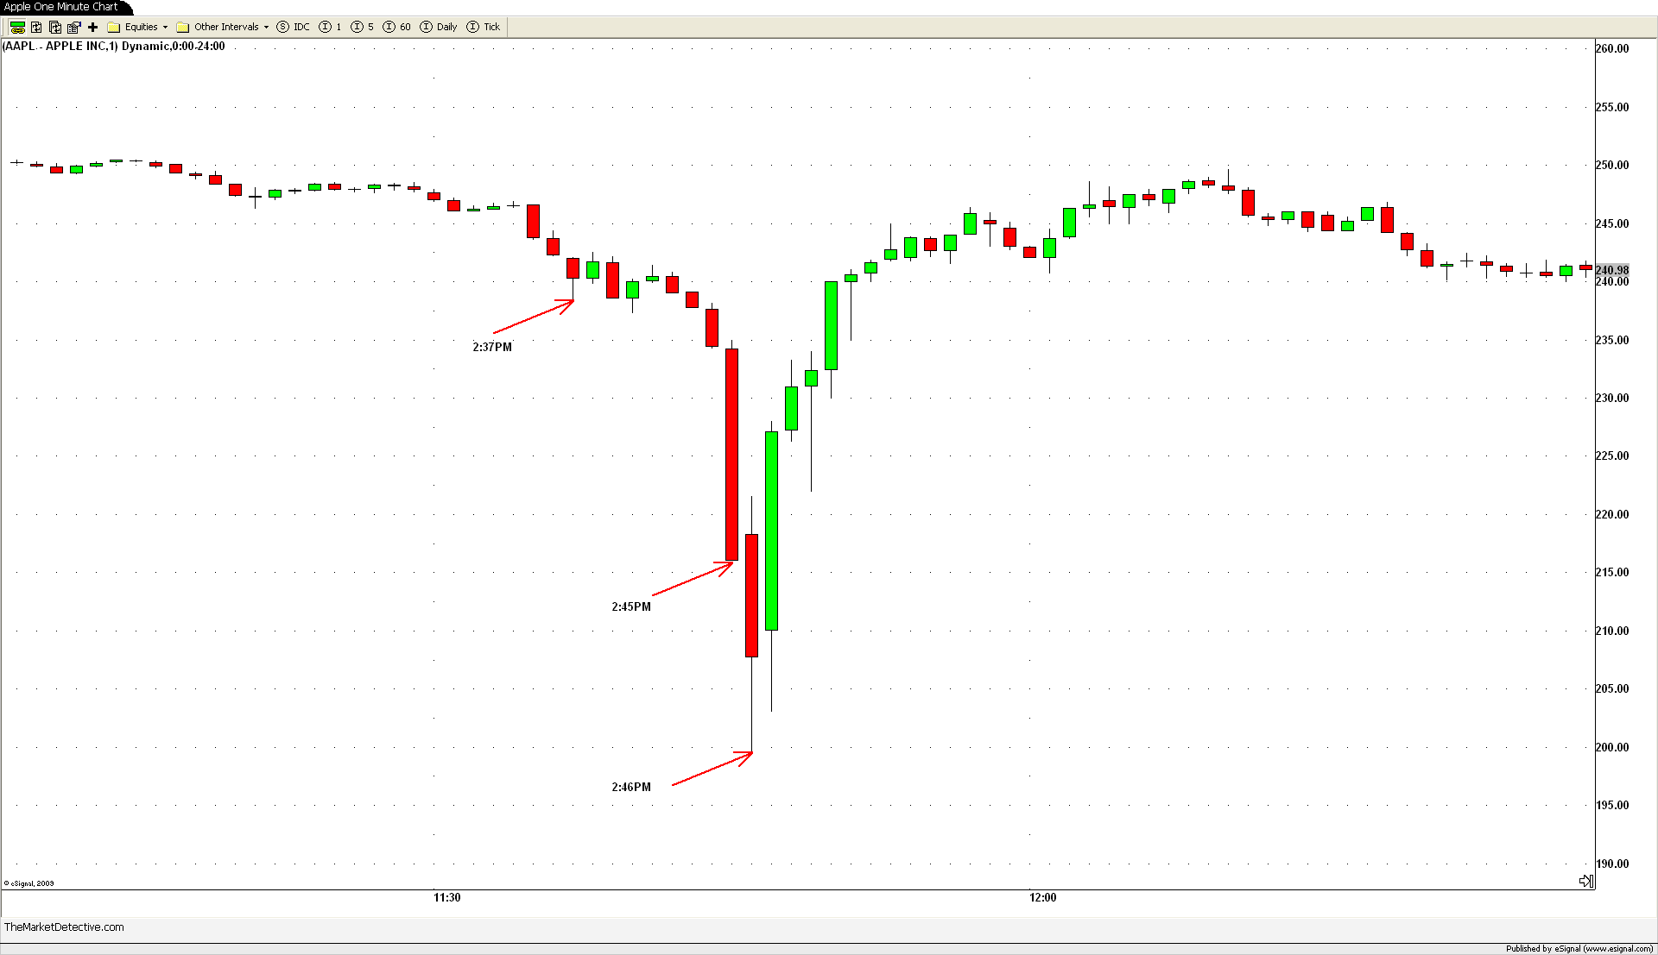
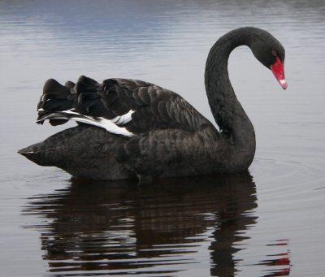

Trend #4: Computational Finance
High frequency trading (HFT): algo trading poster child
2010: HFT drives ~60-70% of equity trades
2012: HFT drives ~80% of equity trades, ~90-95% of quotes
Apple stock in 2009
Forrest Iandola forresti@eecs.berkeley.edu
Notes:
Black swan = metaphor for rare events and long tails
Middle diagram = apple stock during flash crash
Michael Lewis = anti-HFT
Peter: despite how

Slide 18
Hybrid HFT/Algorithmic Trading Structure
Stereotypical algorithmic trading architecture
Our focus
Co-located trading infrastructure
Offline Algorithmic Trading
Analyze historical and recent data
Find correlations
Determine pairs for next day
Exchange
(NASDAQ /NYSE)
Trades
Execution of
pair trade
IBM ↑
MSFT ↑
Updated prices
~10 μs
the “inner” loop
Once a day
Forrest Iandola forresti@eecs.berkeley.edu
Notes:
Modern HFT infrastructure in 2 parts.
Pair trade: have a hypothesis that IBM and MSFT stock are correlated. Execute trades based on this hypothesis on the order of 10 microseconds.
Outer loop: analyze historical data, find correlations
TODO: add bling to algo trading strategy?
Can generalize to "basket trading," which is "trading a basket of correlated stocks"

Slide 19
Hybrid HFT/Algorithmic Trading Structure
Proposed algorithmic trading architecture
Our focus
Co-located trading infrastructure
Bringing Algorithmic Trading Online
Analyze historical and recent data
Find correlations
Determine pairs for next 100ms
Exchange
(NASDAQ /NYSE)
Trades
Execution of
pair trade
IBM ↑
MSFT ↑
Updated prices
~10 μs
the “inner” loop
~1-100 ms
Forrest Iandola forresti@eecs.berkeley.edu
Notes:
Modern HFT infrastructure in 2 parts.
Pair trade: have a hypothesis that IBM and MSFT stock are correlated. Execute trades based on this hypothesis on the order of 10 microseconds.
Outer loop: analyze historical data, find correlations
TODO: add bling to algo trading strategy?
Can generalize to "basket trading," which is "trading a basket of correlated stocks"

Slide 20
Real-Time Correlation Analysis
  Computing correlations of a small number of stocks (e.g. 20) for a large number of time steps (e.g. millions to billions)
  Tall-skinny matrix shape requires different parallelization strategy than large square shape
  Great fit for Berkeley CARMA SEJITS specializer – faster than vendor BLAS libraries for tall-skinny matrix apps
prices
INTC
-0.53 -0.53 -0.53 -0.58 -0.60 …
FB
2.38 2.43 2.43 2.44 2.45 …
MSFT
0.98 0.97 0.98 0.99 1.00 …
GOOG
8.23 8.30 8.31 8.30 8.31 …
. . .
prices
INTC
-0.53 -0.53 -0.53 -0.58 -0.60 …
FB
2.38 2.43 2.43 2.44 2.45 …
x
MSFT
0.98 0.97 0.98 0.99 1.00 …
GOOG
8.23 8.30 8.31 8.30 8.31 …
. . .
Forrest Iandola forresti@eecs.berkeley.edu

Slide 21
Patterns in Computational Finance
 | Web Search | Social Networks | Database | Big Data Analytics | HPC | Genomics | UAV & Wearable Vision | Big Data Multimedia | Finance
Graph Algorithms
Graphical Models
Backtrack / B&B
Finite State Machines
Circuits
Dynamic Programming
N-Body
Unstructured Grid
Structured Grid
Dense Matrix
Sparse Matrix
Spectral (FFT)
Monte Carlo
Apps
Patterns
Forrest Iandola forresti@eecs.berkeley.edu

Slide 22





Trend #5: Online Advertising
"Kurt let me tell you, advertising is running silicon valley." Jim Smith, Mohr Davidow Ventures
Advertising is a half-trillion dollar market
90% of Google's revenue is advertising [1]
Online ad placement with real-time bidding (RTB)
  20% of web display ads are served via RTB; growing quickly
  [1] http://investor.google.com/financial/tables.html
Forrest Iandola forresti@eecs.berkeley.edu

Slide 23
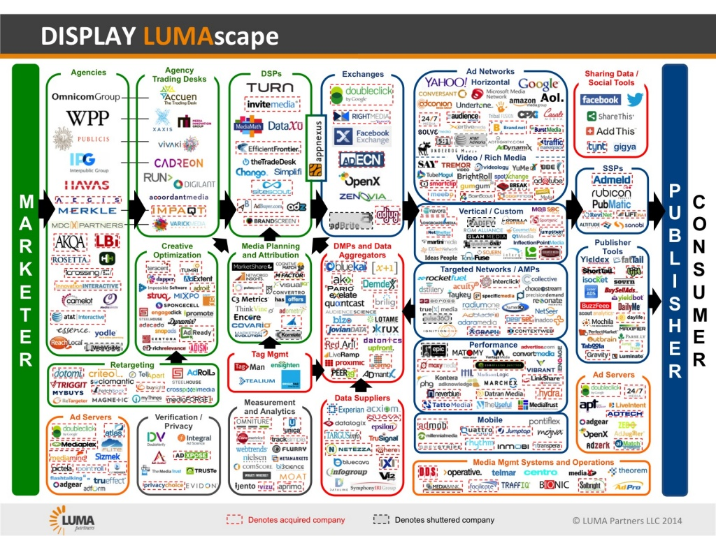
Online Advertising Ecosystem
(1000 companies and growing)
Trading Desks
Exchanges
Generalized
Ad Networks
Demand Side Platforms
Ad Agencies
Supply Side Platforms
Specific
Ad Networks
Media Planning
Creative Optimization
Publisher Tools
Data Management Platforms
Audience Management Platforms
Data Suppliers
Forrest Iandola forresti@eecs.berkeley.edu
Notes:
Ecosystem of ad producers, consumers, and helpers.
Not doing a deep dive; just wanted to make you aware of it

Slide 24
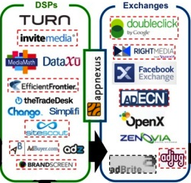
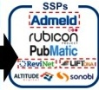
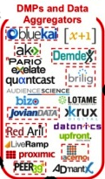
Ad Placement w/ Real-Time Bidding
Demand Side Platforms
Exchanges
Supply Side Platforms
Data Management Platforms
Forrest Iandola forresti@eecs.berkeley.edu

Slide 25





Ad Placement w/ Real-Time Bidding
100ms latency cap
Do you want to bid
on user 123456?
User 123456 just
opened page http://…
Demand-Side
Platform
Ad Exchange
Publisher
Yes, we will bid
$0.02 to serve an ad to 123456
an ad from DataXu for $0.02 is the top bidder
calculate top bid
Join us at
user 123456 lives in Berkeley and likes the AMPLab
Do we know anything about user 123456?
Data Aggregator
Forrest Iandola forresti@eecs.berkeley.edu

Slide 26
Trajectory of Real-Time Bidding
100ms latency cap
Do you want to bid
on user 123456?
Latency
Demand-Side
Platform
Ad Exchange
Yes, we will bid
$0.02 to serve an ad to 123456
calculate top bid
Volume
user 123456 lives in Berkeley and likes the AMPLab
Do we know anything about user 123456?
Computing
per byte of
ads served
Data Aggregator
Forrest Iandola forresti@eecs.berkeley.edu
Notes:
In addition to reduction in latencies and increase in advertising volume we anticipate that there will be more “behind the scenes” computing to determine the right price and right target for every ad served.

Slide 27
Patterns in Online Advertising
 | Web Search | Social Networks | Database | Big Data Analytics | HPC | Genomics | UAV & Wearable Vision | Big Data Multimedia | Advertising | Finance
Graph Algorithms
Graphical Models
Backtrack / B&B
Finite State Machines
Circuits
Dynamic Programming
N-Body
Unstructured Grid
Structured Grid
Dense Matrix
Sparse Matrix
Spectral (FFT)
Monte Carlo
Apps
Patterns
Forrest Iandola forresti@eecs.berkeley.edu

Slide 28
Computational Characteristics of Cluster/Cloud Applications
 | Web Search | Social Networks | Database | Big Data Analytics | HPC | Genomics | UAV & Wearable Vision | Big Data Multimedia | Advertising | Finance | Visual- ization
Graph Algorithms
Graphical Models
Backtrack / B&B
Finite State Machines
Circuits
Dynamic Programming
N-Body
Unstructured Grid
Structured Grid
Dense Matrix
Sparse Matrix
Spectral (FFT)
Monte Carlo
Apps
Patterns
Forrest Iandola forresti@eecs.berkeley.edu

Slide 29
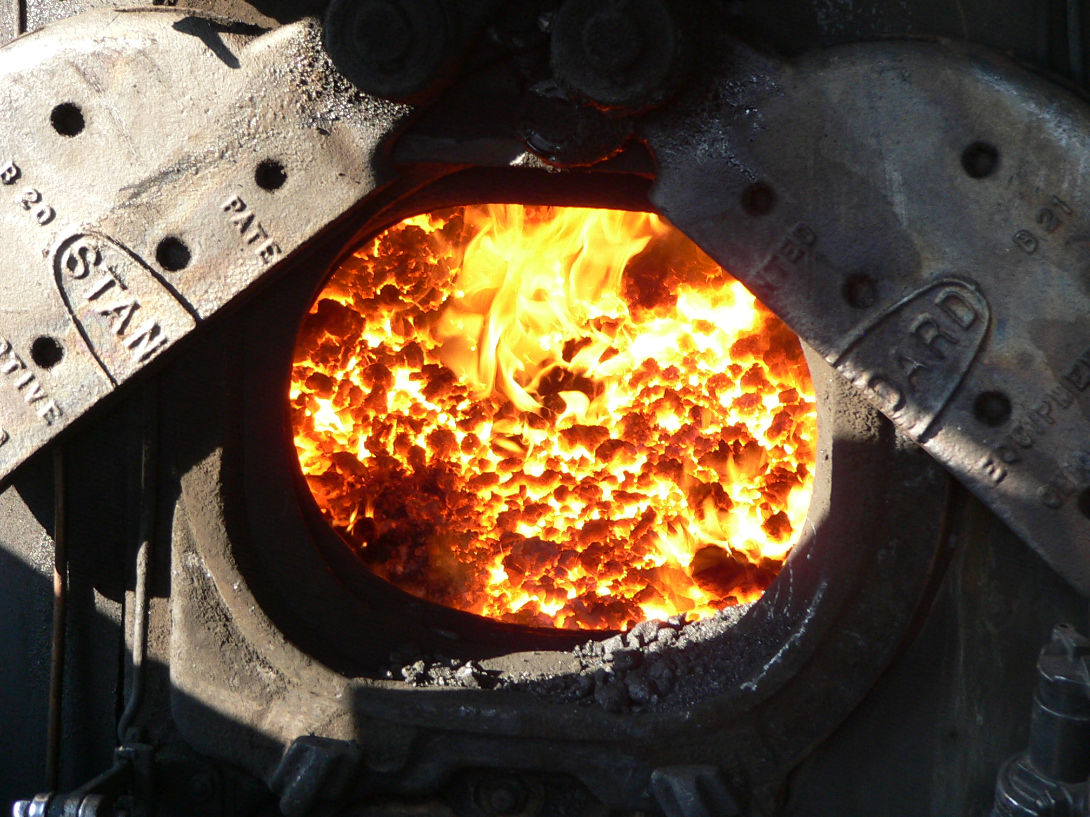
Summary of Application Characteristics
High growth / high economic impact areas
Common Characteristics:
  Big data (>= Petabytes of data per day)
  Low latency (~ <1ms)
  Streaming real-time computation
Sound Familiar?
FireBox!
Notes:
Common app areas
Most of these apply to most apps
TODO: make this anatomically correct

Slide 30
Conclusions
Formula for application-driven research:
  identify key growth areas
  UAVs, wearable computing, big data analytics, finance, advertising
  map these growth areas and their applications to computational patterns
  FFT, dense, sparse, monte carlo, etc
  drill down to specific applications, build flexible and efficient pattern frameworks (e.g. SEJITS)
  pair trading, PyCASP for multimedia, dual-use optical flow
Drive research on FireBox, hardware, and software frameworks with these applications
Sounds good? (industry and DARPA, looking at you…)
Forrest Iandola forresti@eecs.berkeley.edu

Slide 31
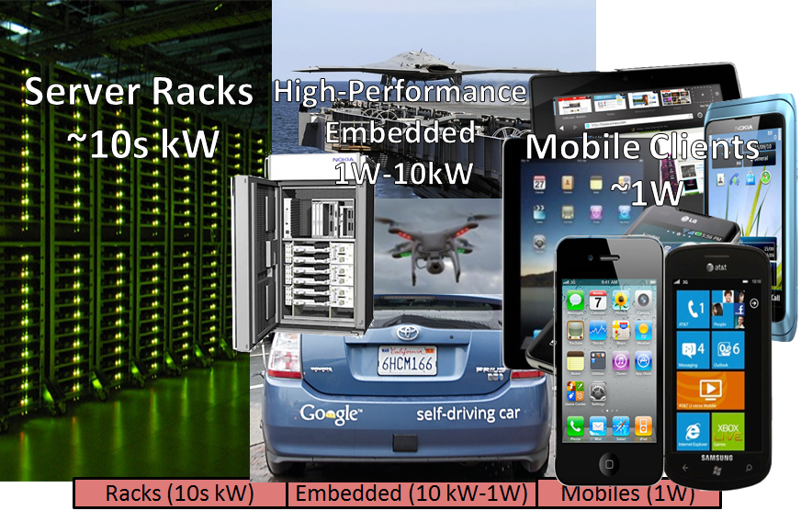
Extras
Forrest Iandola forresti@eecs.berkeley.edu

Slide 32
Online Advertising Ecosystem
Trading Desks
Demand Side Platform
Exchanges
Generalized
Ad Networks
Ad Agencies
Supply Side Platform
Specific
Ad Networks
Creative Optimization
Media Planning
Audience Management Platform
Publisher Tools
Data Management Platform
Data Suppliers
Forrest Iandola forresti@eecs.berkeley.edu

Slide 33
FireBox to the rescue for latency sensitive big-data applications
Consider ad placement:
Ad placement engines will attempt to do increasingly sophisticated algorithms within the <=100ms latency cap
Each ad placement bid may require many database queries; tail-tolerance is important for timely bid placement
TODO: how many queries? (look at how Google F1 database for stuff like this)
(TODO: other applications besides advertising?)
Forrest Iandola forresti@eecs.berkeley.edu

Slide 34
UAV Computer Vision Application
  Key Application: Target tracking aimed to use the video capabilities in the Predator MQ-9
    Automated detection
    Target tracking
    Surveillance
Performance Goal: 140 Frames/kJoule for 2048x2048 frames
  2000× improvement over state of the art
Predator MQ-9 UAV

Slide 35
Our Pattern-oriented Approach
Key application
Application capabilities
Application patterns
Computational patterns
Communication avoiding parallel algorithms
HW/SW implementation using SEJITS
Notes:
Our approach is to identify key applications and their application capabilities, distil these into application patterns and then computational patterns, implement these using communication-avoiding parallel algorithms and then target the breadth of ASPIRE targets using SEJITs

